Slide 1
Blockchain
and cryptocurrency
Notes:
Entered text
### Introduction
- **Overview of Blockchain Technology**: Briefly describe what blockchain is, focusing on its decentralized and secure nature.
- **Importance of Security**: Emphasize why security is crucial in blockchain systems, considering their use in financial transactions and data storage.
### The Nature of Blockchain Hacking
- **How Hacking Differs in Blockchain**: Explain how hacking in blockchain differs from traditional hacking due to its unique structure.
- **Common Misconceptions**: Address common misconceptions about blockchain's invulnerability.
### Types of Blockchain Hacks
- **51% Attacks**: Discuss the concept of a 51% attack, where a single entity gains control of the majority of a network's mining power.
- **Code Exploits and Smart Contract Vulnerabilities**: Explain how bugs in code or smart contracts can lead to vulnerabilities.
- **Sybil Attacks**: Describe Sybil attacks where a single entity creates multiple fake identities to gain network influence.
### Notable Blockchain Hacks
- **Historical Examples**: Provide examples of significant blockchain hacks, such as the DAO attack on Ethereum.
- **Impact of These Hacks**: Discuss the financial and trust-related impacts of these hacks on the blockchain community.
### Mitigating Hacking Risks
- **Security Measures**: Outline security measures and best practices to prevent hacking, such as regular audits and employing multi-signature systems.
- **Role of the Community**: Highlight the importance of the blockchain community in identifying and addressing security threats.
### Conclusion
- **Recap of the Importance of Security**: Conclude by reiterating the importance of security in maintaining trust and functionality in blockchain systems.
references

Slide 2
Introduction
Artem Surzhenko

Slide 3
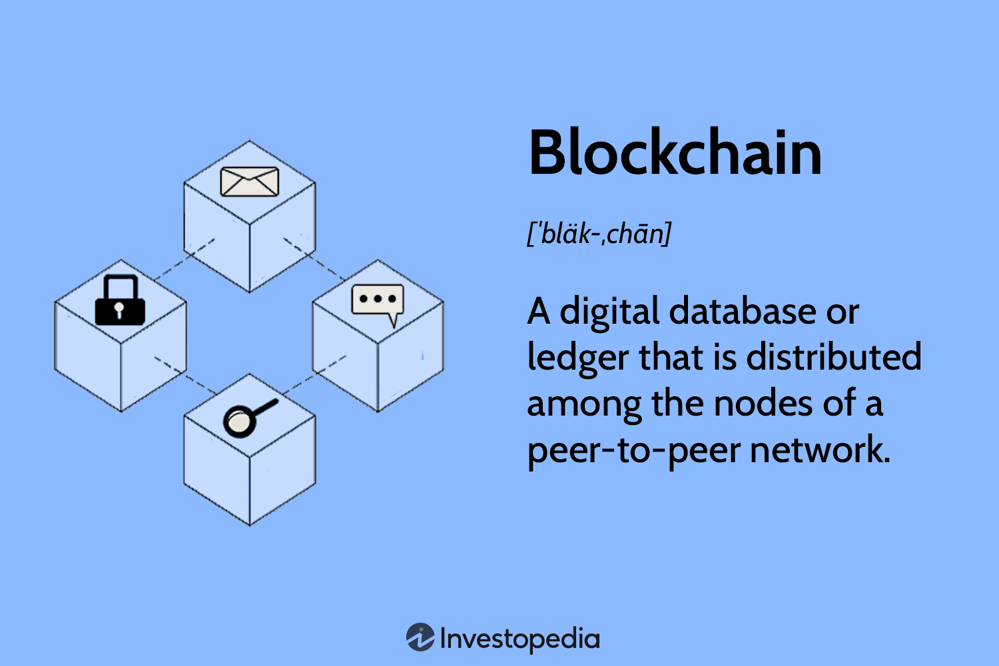
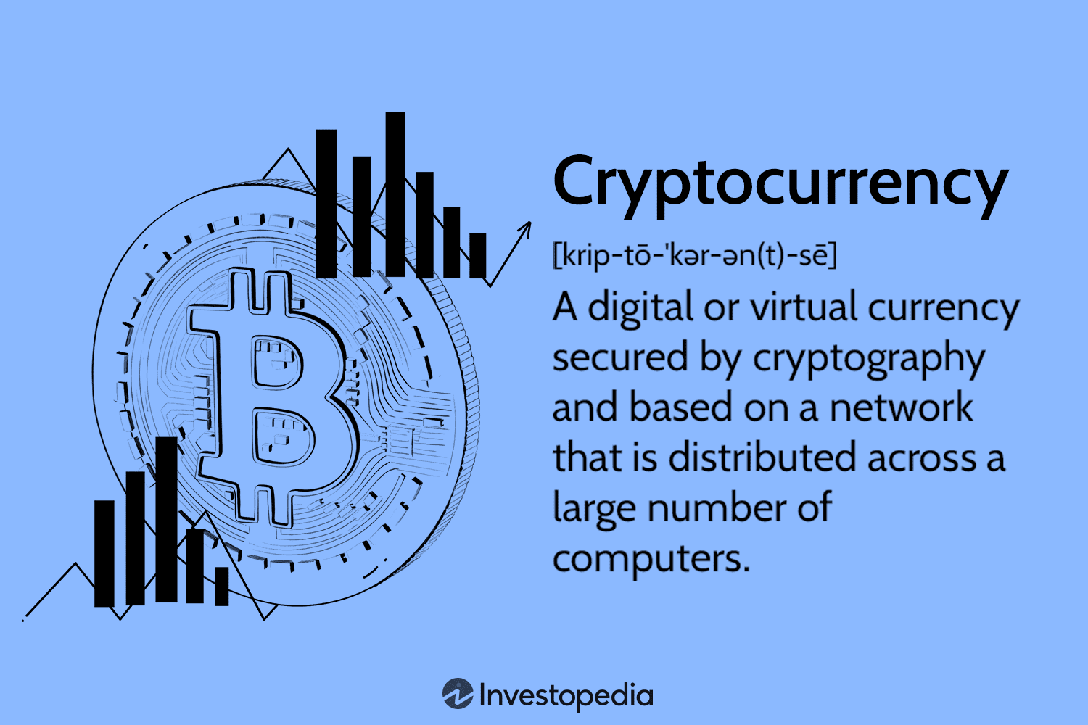
Blockchain Cryptocurrency

Slide 4
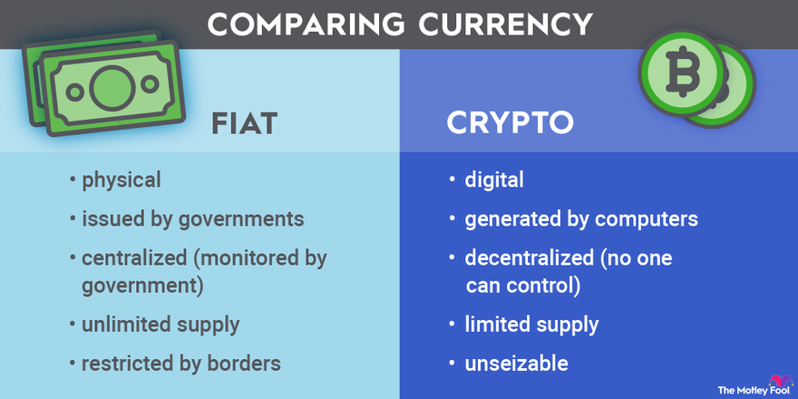
How is cryptocurrency different from regular money?

Slide 5

Cryptocurrency extraction and mining
Cryptocurrency mining means adding new blocks to the blockchain chain. This process is difficult and requires enormous computing power.

Slide 6
Designed by Artem Surzhenko (Introduction Part)

Slide 7
Banking and Bitcoin
Matvii Vasylenko

Slide 8


Online Banking – money goes digital
Before crypto - late 20th and early 21st centuries banking.

Slide 9

1980s
Evolution of payment system, debit/credit cards and standards VISA & MASTERCARD.

Slide 10

Smartphone
2002 - 2008
Growth of the smartphone market and its rapid technological leap in future.

Slide 11
How big is this trend?
From the 2023 report of an independent marketing platform GITNUX:
Online banking usage in the United States increased from 36% in 2005 to 73% in 2021.
51% of US adults use digital banking, with 81% of them accessing their accounts via mobile platforms.
The global online banking users is expected to reach 3.6 billion by 2024.
89% of UK adults now use online banking, and 64% use mobile banking apps.

Slide 12

Digital Currencies - money in air
Central Banking Systems around the world - started to create and convert their currencies into "Digital Format"
Honourably the first steps in this direction are taken by the USA, after which all other big nations joined in: Japan, EU, Canada, UK.

Slide 13
How Bitcoin works?
🧑
⛏️👷‍♂️
Very-very-very-simple explanation
👨

Slide 14
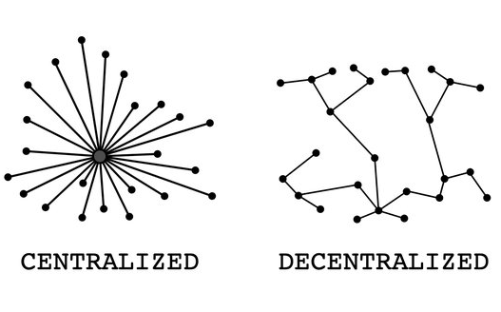
Decentralization
Government
Freedom
Control
Stability
Prevalence
Innovators
Independence
Modern

Slide 15
CONCLUSION:
Designed by Matvii Vasylenko (Banking and Bitcoin Part)

Slide 16
Hacking
Danyil Tymchuk

Slide 17

Introduction
Notes:
Blockchain is like a digital ledger, but instead of being kept in one place, it's spread out across a whole network of computers. Think of it as a record book that everyone can see, but no one owns. This setup is really cool because it means there's no central control - it's all about teamwork across many computers.

Slide 18
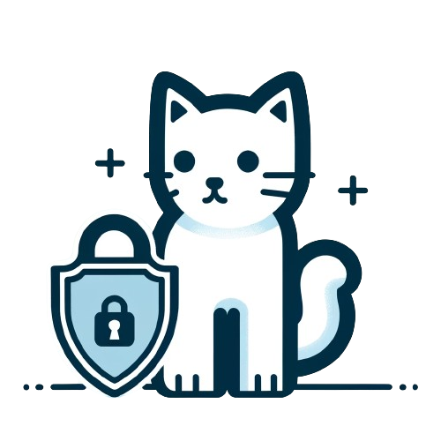
Importance of Security
Notes:
Now, why is this security thing a big deal? Imagine you're using blockchain for something super important, like transferring money or keeping sensitive data. You don't want anyone messing with that, right? That's where blockchain's security shines. Each piece of data (or block) is tied to the previous one using complex cryptography. This makes it super tough for anyone to change anything without everyone else noticing. So, in a world where we're doing more and more online, having a safe and secure way to handle our digital stuff is super important, and that's exactly what blockchain offers.

Slide 19

The Nature of Blockchain Hacking
How Hacking Differs in Blockchain
Common Misconceptions

Slide 20
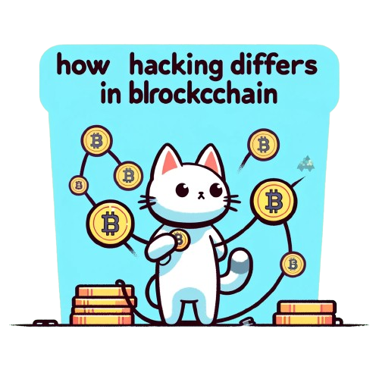
How Hacking Differs in Blockchain
Notes:
Hacking in the blockchain world is a different beast compared to traditional hacking, mainly due to blockchain's unique structure. In traditional systems, hackers often target central points of control or vulnerabilities in a single system. But with blockchain, there's no central point to attack because the data is distributed across a network of computers, each holding a copy of the ledger. This means to hack a blockchain, a hacker would need to alter the majority of the copies simultaneously, a task that's not only incredibly difficult but also requires immense computational power.

Slide 21

Common Misconceptions
Notes:
However, there's a common misconception that blockchain is totally invulnerable. While it's true that blockchain's design makes it tough to hack in the traditional sense, it's not foolproof. For instance, if someone gains control over more than half of the network's computing power, a scenario known as a 51% attack(I will talk about it later), they could potentially alter the blockchain. Even with blockchain's strong security, there are still some weak spots. Think about smart contracts or the software that runs the blockchain - if they're not set up perfectly, hackers could sneak in through those gaps. So, while blockchain is really secure, it's not completely unbeatable.

Slide 22
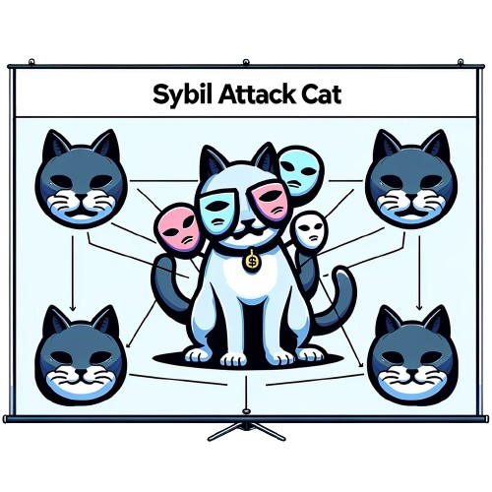
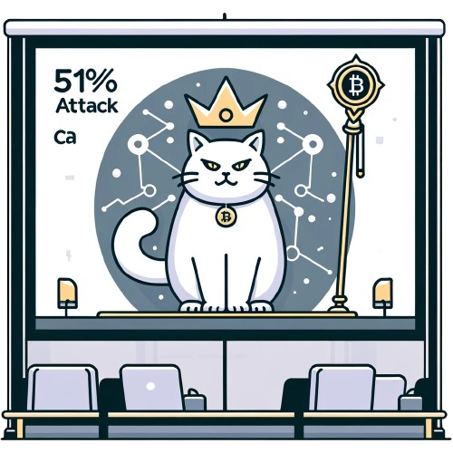

Types of Blockchain Hacks
Backdoor Attack
Sybil Attack
51% Attack

Slide 23
51% Attacks
Notes:
This happens in a blockchain network when a single person or group controls more than 50% of the network's mining power. In blockchain, "mining" involves validating transactions and creating new blocks. If someone has over half the network's power, they can potentially manipulate the blockchain. They could stop new transactions from getting confirmations, allowing them to halt payments. Even scarier, they could reverse transactions they made while they're in control, which could lead to double-spending. However, pulling off a 51% attack is tough, especially on larger networks like Bitcoin, because it requires immense computational resources.

Slide 24
Backdoor
Notes:
Code Exploits and Smart Contract Vulnerabilities: Imagine the blockchain as a complex machine running on code. Sometimes, there are hidden flaws in this code. Hackers love to find and use these flaws. It's like finding a secret door into a bank vault. Smart contracts are like automatic agreements on the blockchain. If they're not written carefully, they can have weaknesses too. Hackers can use these weak spots to do things like steal digital money.

Slide 25
Sybil Attacks
Notes:
This is like one person pretending to be many people on the blockchain. They create a bunch of fake identities to gain more power or control in the network. It's like one person wearing lots of different masks to trick others. With all these fake identities, they can mess with the network by spreading false information or overwhelming it with fake transactions. It is somewhat similar to a 51% attack but much smaller, because sybil attacks can occupy a maximum of 1-2% of the network.

Slide 26

Notable Blockchain Hacks

Slide 27

DAO Attack
2016 year
-50$ millions
Backdoor Attack
Notes:
Blockchain technology, known for its security, has still faced some notable hacks over the years. A prime example is the DAO attack on Ethereum in 2016. The DAO (Decentralized Autonomous Organization) was a complex smart contract on the Ethereum blockchain, designed to function as a sort of investor-directed venture capital fund. However, due to a flaw in its code, a hacker managed to drain about a third of the DAO's funds, amounting to around $50 million in Ethereum.

Slide 28

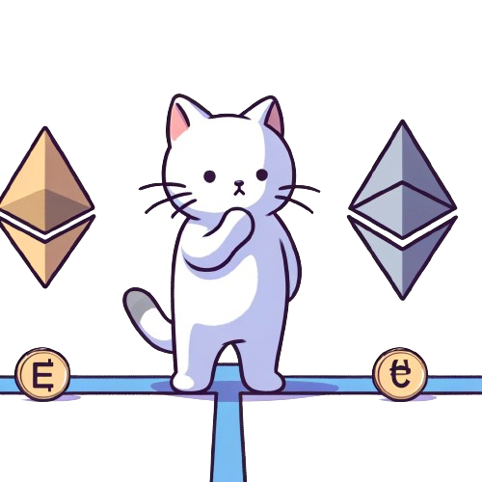

Hard-fork
Ethereum (ETH)
Ethereum Classic (ETC)
Notes:
When these big hacks happen, it's not just about losing money. People start to doubt how safe blockchain really is. Take the DAO attack on Ethereum as an example. It was a huge deal because a lot of money was stolen. But the reaction to the hack was even more dramatic. The Ethereum community decided to essentially go back in time and create a new version of Ethereum where the hack never happened. This move was called a "hard fork". It's like taking a road and then splitting it into two different paths.
This decision caused a lot of arguments. Some people thought it was the right thing to do to fix the problem. Others thought it went against the whole idea of blockchain being unchangeable and secure. So, Ethereum split into two: Ethereum (ETH) and Ethereum Classic (ETC).

Slide 29

Mitigating Hacking Risks
Security Measures
Role of the Community

Slide 30

Security Measures
Notes:
To keep blockchain safe from hackers, a couple of smart moves are key. First, think of regular audits like a health check for blockchain. Experts look over the code, hunting for any sneaky bugs that hackers could use to cause trouble. It's all about catching issues early.
Then there's the cool idea of multi-signature systems. It's like needing several thumbs up instead of just one to make something happen. In blockchain land, this means more people need to say 'okay' before a transaction goes through. It's like having a bunch of people double-checking each other, making things a lot safer.

Slide 31

Role of the Community
The power of the people!
Notes:
The power of the people!
The blockchain community is super important. Everyone needs to keep their eyes peeled and report anything fishy. It's like having a neighborhood watch for the digital world. By everyone chipping in and staying sharp, the blockchain stays strong and secure. It's teamwork at its best!

Slide 32

Conclusion
“No matter how advanced the system is, anything can be hacked”
Notes:
Finally, Would like to say that no system is 100% secure, but blockchain technology wants to provide unlimited freedom and decentralization, as well as a large part of security
No matter how advanced the system is, anything can be hacked

Slide 33
Designed by Danyil Tymchuk (Hacking Part)

Slide 34
Copy
04.12.2023
Designed by Danyil Tymchuk & Matvii Vasylenko & Artem Surzhenko

